Slide 1


Public Employees Insurance Program (PEIP)
PEIP 2025 Renewal
Innovo Benefits
952-746-3101

Slide 2
January 2025 PEIP Renewal
The renewal rates for January 2025 will be based on a combination of the group’s claims and the overall pool. Group’s credibility is based on enrollment size.
The 2025 clinic directory is available at www.innovomn.com. Please check to see if your clinic cost level has changed.
Innovo Benefits Administration encourages you to use our PEIP Online Enrollment Portal. You can access the Online Enrollment Portal by visiting – https://www.mnpeip.com. Please consult with your HR Office prior to submitting changes online.
No member action is required unless you are changing networks (BC/HP) or changing plan designs (High, Value or HSA). If you are changing clinics only, please call the customer service number on your ID card.

Slide 3
Plan Changes for 2025
There are a few plan revisions for 2025
The HSA plan deductible increased due to IRS rules.
Office visit copy increased by $5 on the High plan only.
Both carriers, BCBS and HP, offer a fitness discount to their members, to view details please visit their websites.
    www.bluecrossmn.com/peip
    www.healthpartners.com/peip
Some clinic cost levels have changed, please refer to the new directory to check your clinic.

Slide 4
PEIP
&
Innovo Benefits
The Public Employee Insurance Program (PEIP) is a state of Minnesota health plan available to cities, counties and school districts. PEIP is able to leverage off the state employee plan and use the negotiating clout of their size to offer very low administrative costs and multiple network carriers to our member groups.
Deloitte, the world’s largest professional services organization, handles the financials, underwriting, and consulting.
Innovo Benefits is the third-party administrator for the PEIP program. Our core staff has worked with the PEIP program since it was created.
Our strength is vast experience and dedication to servicing the PEIP program. Our 30 years of experience has proven to be vital in dealing with the myriad of issues that arise in servicing our employers and members.
The PEIP pool has grown to approximately 300 employer groups covering 35,000 members.

Slide 5
Overview of PEIP Coverage
Members have the choice of three plan design options and two network carriers.
Primary Care Clinic model where clinics are broken down into 4 tiers or cost levels (CL).
Each family member can choose their own primary care clinic (PCC) and your benefit level is based on the cost level of your PCC choice. More efficient, lower cost clinics provide the highest benefit levels.
Generally, all routine and non-emergency care flows through your primary care, referrals are typically required for care outside your PCC.
Prescription drugs are through the CVS Caremark network for both network carriers.
CVS Caremark has a large network of pharmacies throughout the state/country. You do not have to use a CVS Retail pharmacy.

Slide 6
Step by Step Instructions will guide
You through the enrollment steps and provide information you need to make election choices.
Step 1 – Choose Your Plan Level
Advantage High is the highest level of benefits and the highest payroll deduction.
Advantage Value has a slightly lower level of benefits but also a lower payroll deduction.
HSA option has highest deductible and out of pocket expenses and the lowest payroll deduction.
One plan is selected for employee + 1 and family coverage.
You can change your plan level each year during open enrollment.

Slide 7
Step 2 – Choose Your Health Plan/
Network
HealthPartners
Blue Cross Blue Shield
Network selection does not affect the cost of the plan or your premium rate.
Both networks have the same plan design levels.
One network is selected for employee + 1 and family coverage.
You can change your network each year during open enrollment.

Slide 8
Step 3 – Choose Your Primary
Care Clinic
Primary Care Clinics (PCC) are placed in four cost levels, based on the care system and overall cost/quality of their delivery of care.
Your final benefit level is based on the on the cost level of the primary clinic you choose related to your Health Plan and Network choice.
You will choose a primary care clinic (PCC) for each family member.
PCC does not need to be the same for each family member, nor the same Cost Level.
PCC can be changed monthly by calling your network carrier customer service number on the back of your ID card.
2025 clinic directory will be available at www.innovomn.com beginning in October.

Slide 9
Specialists
Referrals to specialists are covered at the same cost level as your PCC.
Members can Self-Refer* to specialists for OBGyn, Mental Health, Chemical Dependency, Chiropractic Care and Routine Vision.
*Practitioners must participate in your network carrier’s self-referral network.
No referrals are needed for Urgent Care or Emergency Services.
CVS Caremark (PBM)
CVS Caremark is the pharmacy benefit manager for PEIP and provides services for all three networks.
Nationwide network of more than 68,000 participating retail pharmacies.
PEIP includes both CVS and non-CVS pharmacies. Pharmacy locator tool at www.innovomn.com.
Convenient access to retail, specialty services and mail order delivery options.

Slide 10
PEIP Plan Documents and Information
Once enrolled, you will receive two ID cards.
1) One ID card is for medical and will come from your network choice (HP, BC).
2) The second ID card is for all pharmacy services and will come from CVS Caremark.
All PEIP plan documents and tools
are posted on the PEIP website at
www.innovomn.com.
The website includes Plan Summaries and
Plan Documents, Statewide Clinic Directory, Summary Benefit Comparisons (SBC’s), Pharmacy Tools and informative Q&A.
PEIP Customer Service is available from:
7:30am to 4:30pm
952-746-3101
800-829-5601
Or eMail your question to
service@innovomn.com

Slide 11
High Plan

Slide 12
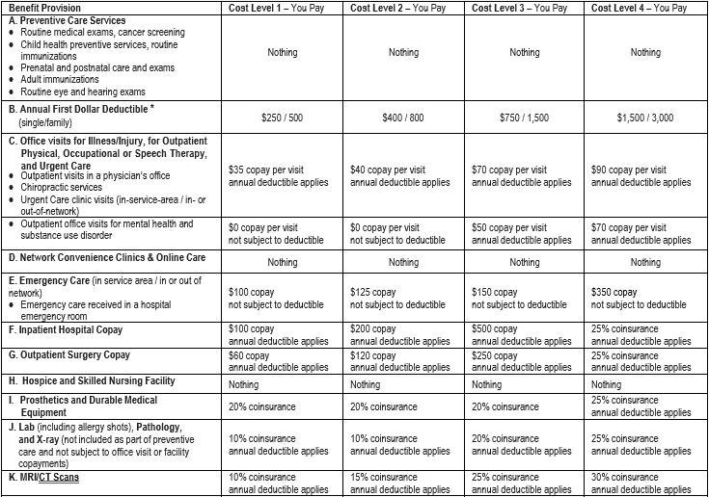
Minnesota Public Employees Insurance Program (PEIP)
Advantage Health Plan High Option 2025 - 2026 Benefits Schedule
Advantage High plan
Highest benefit level
(Highest payroll deduction)
Preventive Routine Care
covered at 100%
Network Convenience Clinics and Online Care Clinics
Covered at 100%

Slide 13
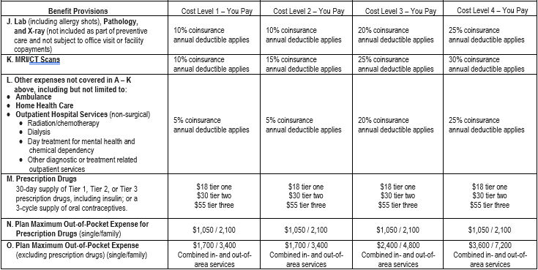
Minnesota Public Employees Insurance Program (PEIP)
Advantage Health Plan High Option 2025 - 2026 Benefits Schedule
Advantage High plan
Prescription Drugs
No Deductible
Copay per 30 day supply
Typically tiers are broken out …
Tier 1 – $18, generic & common name brand
Tier 2 – $30, name brand, some generic & specialty
Tier 3 – $55, typically specialty medications
(If medications are less than the copay, only pay the price of medication.)
Formulary tools for pricing covered meds at www.innovomn.com
RX Out of Pocket Max - $1,050/$2,100
Mail Order for 90 day medications for 2 copays
(also available at retail CVS pharmacies)

Slide 14
Minnesota Public Employees Insurance Program (PEIP)
Advantage Health Plan High Option 2025 - 2026 Benefits Schedule
Advantage High plan
Your Deductible is based on your cost level.
CL 1 - $250/$500
CL2 – $400/$800
(Higher cost clinics, CL3 and CL4, will have higher deductibles.)
CL3 - $750/$1,500
CL4 - $1,500/$3,000
Medical Deductible is paid in full by the member first, then member is only responsible for copayments or coinsurance.
Deductibles are embedded.

Slide 15
Minnesota Public Employees Insurance Program (PEIP)
Advantage Health Plan High Option 2025 - 2026 Benefits Schedule
Advantage High plan
After the deductible has been satisfied, member only pays copayments or coinsurance for services.
Copayment is a flat dollar amount for visit or service.
Coinsurance is a % amount of the bill.
Prosthetics and Durable Medical bypass the deductible with member paying only 20% copay (25% with CL4).
Network Convenience Clinics & Online Care, Hospice – no deductible, no copay

Slide 16
Minnesota Public Employees Insurance Program (PEIP)
Advantage Health Plan High Option 2025 - 2026 Benefits Schedule
Advantage High plan
Medical Out of Pocket Maximum
Once the deductible, copays and coinsurance expenses for medical total a certain level, the plan covers 100% of eligible medical expenses for the remaining contract year.
Your Medical OOP Max is based on your cost level.
CL1 - $1,700/$3,400
CL2 - $1,700/$3,400
(Higher cost clinics, CL3 and CL4, will have higher OOP max.)
CL3 - $2,400/$4,800
CL4 - $3,600/$7,200
OOP Max is embedded.

Slide 17
Value Plan
No Voiceover for the next 5 Slides

Slide 18
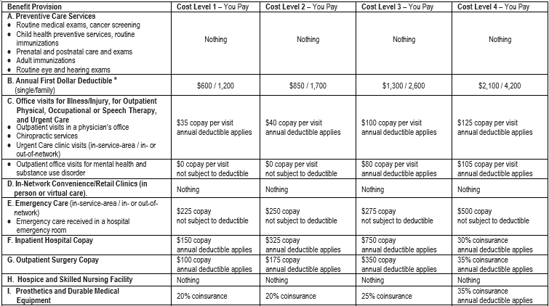
Minnesota Public Employees Insurance Program (PEIP)
Advantage Health Plan Value Option 2025 - 2026 Benefits Schedule
Value Plan
Mid-range benefit level
Preventive Routine Care
covered at 100%

Slide 19
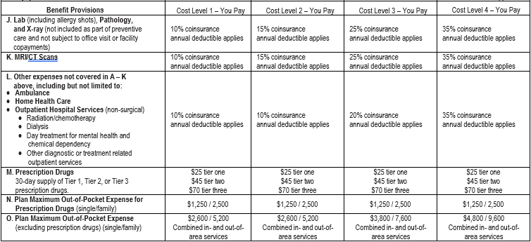
Minnesota Public Employees Insurance Program (PEIP)
Advantage Health Plan Value Option 2025 - 2026 Benefits Schedule
Value Plan
Prescription Drugs
No Deductible
Copay per 30 day supply
Typically tiers are broken out …
Tier 1 – $25, generic & common name brand
Tier 2 – $45, name brand, some generic & specialty
Tier 3 – $70, typically specialty medications
(If medications are less than the copay, only pay the price of medication.)
Formulary tools for pricing covered meds at
www.innovomn.com
RX Out of Pocket Max - $1,250/$2,500
Mail Order for 90 day medications for 2 copays
(also available at retail CVS pharmacies)

Slide 20
Minnesota Public Employees Insurance Program (PEIP)
Advantage Health Plan Value Option 2025 - 2026 Benefits Schedule
Value Plan
Your Deductible is based on your cost level.
CL 1 - $600/$1,200
CL2 – $850/$1,700
(Higher cost clinics, CL3 and CL4, will have higher deductibles.)
CL3 - $1,300/$2,600
CL4 - $2,100/$4,200
Medical Deductible is paid in full by the member first, then member is only responsible for copayments or coinsurance.
Deductibles are embedded.

Slide 21
Minnesota Public Employees Insurance Program (PEIP)
Advantage Health Plan Value Option 2025 - 2026 Benefits Schedule
Value Plan
After the deductible has been satisfied, member only pays copayments or coinsurance for services.
Copayment is a flat dollar amount for visit or service.
Coinsurance is a % amount of the bill.
Prosthetics and Durable Medical bypass the deductible with member paying only 20% copay CL1, CL2. (25% CL3, 35% CL4).
Network Convenience Clinics & Online Care, Hospice – no deductible, no copay

Slide 22
Minnesota Public Employees Insurance Program (PEIP)
Advantage Health Plan Value Option 2025 - 2026 Benefits Schedule
Value Plan
Medical Out of Pocket Maximum
Once the deductible, copays and coinsurance expenses for medical total a certain level, the plan covers 100% of eligible medical expenses for the remaining contract year.
Your Medical OOP Max is based on your cost level.
CL1 - $2,600/$5,200
CL2 - $2,600/$5,200
(Higher cost clinics, CL3 and CL4, will have higher OOP max.)
CL3 - $3,800/$7,600
CL4 - $4,800/$9,600
OOP Max is embedded.

Slide 23
HSA Plan

Slide 24
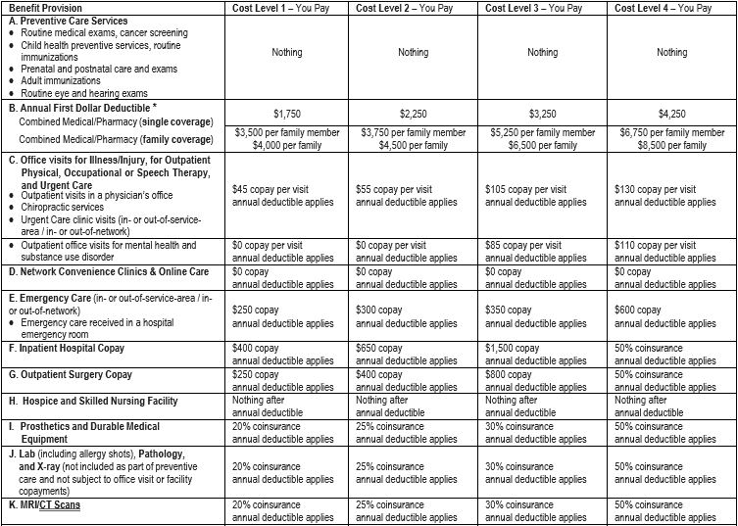
Minnesota Public Employees Insurance Program (PEIP)
Advantage Health Plan HSA-Compatible 2025 - 2026 Benefits Schedule
HSA Plan
High deductible, lowest payroll deduction
HSA plan meets IRS rules for QHDHP and works differently than High & Value plan:
Medical and Prescription Drugs are combined
Deductible must be satisfied before member moves into copayments or coinsurance
Preventive Routine Care
covered at 100%

Slide 25
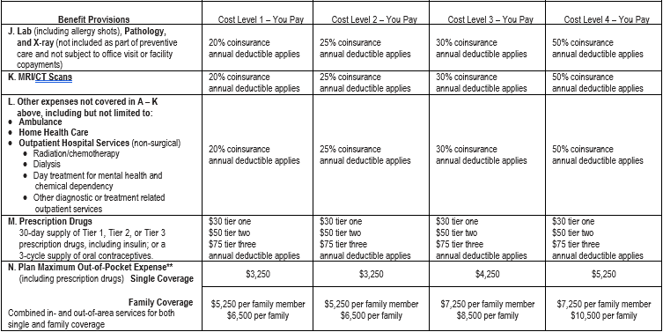
Minnesota Public Employees Insurance Program (PEIP)
Advantage Health Plan HSA-Compatible 2025 - 2026 Benefits Schedule
HSA Plan
Prescription Drugs
After Deductible, Copay per 30 day supply
Typically tiers are broken out …
Tier 1 – $30, generic & common name brand
Tier 2 – $50, name brand, some generic & specialty
Tier 3 – $75, typically specialty medications
(If medications are less than the copay, only pay the price of medication.)
Formulary tools for pricing covered meds at
www.innovomn.com
Mail Order for 90 day medications for 2 copays, after deductible is met (Also available at retail CVS pharmacies)

Slide 26
Minnesota Public Employees Insurance Program (PEIP)
Advantage Health Plan HSA-Compatible 2025 - 2026 Benefits Schedule
HSA Plan
Your Deductible is based on your cost level.
CL 1 - $1,750/$4,000
CL2 – $2,250/$4,500
(Higher cost clinics, CL3 and CL4, will have higher deductibles.) Very few members fall under CL3 and CL4, vast majority are in CL1 and CL2
CL3 - $3,250/$6,500
CL4 - $4,250/$8,500
Note: Family Coverage has an embedded individual deductible.
Deductible is paid in full by the member first for medical and prescription drugs, then member is only responsible for copayments or coinsurance.

Slide 27
Minnesota Public Employees Insurance Program (PEIP)
Advantage Health Plan HSA-Compatible 2025 - 2026 Benefits Schedule
HSA Plan
After the deductible has been satisfied, member only pays copayments or coinsurance for services.
Copayment is a flat dollar amount for visit or service.
Coinsurance is a % amount of the bill.

Slide 28
HSA Plan
Medical & RX Out of Pocket Maximum Combined
Once the deductible, copays and coinsurance expenses for medical and prescription drugs total a certain level, the plan covers 100% of eligible expenses for the remaining contract year.
Your Medical & RX OOP Max is based on your cost level.
CL1 - $3,250/$6,500
CL2 - $3,250/$6,500
(Higher cost clinics, CL3 and CL4, will have higher OOP max.)
CL3 - $4,250/$8,500
CL4 - $5,250/$10,500
Note: Family Coverage has an embedded individual out of pocket maximum.
Minnesota Public Employees Insurance Program (PEIP)
Advantage Health Plan HSA-Compatible 2025 - 2026 Benefits Schedule

Slide 29




Out of Area Coverage
PEIP has revised the out of area benefit plan. Members no longer need to “sign-up” to receive the benefits. Any care out of the service area, MN and bordering counties basically, is covered at cost level 3 for high and value plans, HSA remains the same deductible then 30% coinsurance.
Out of area deductibles are separate from in-network PEIP deductibles but services do accumulate to the out-of-pocket maximums. Always call the phone number on your ID card to verify benefits. Urgent care and emergency care are still covered at the cost level of your primary clinic.

Slide 30
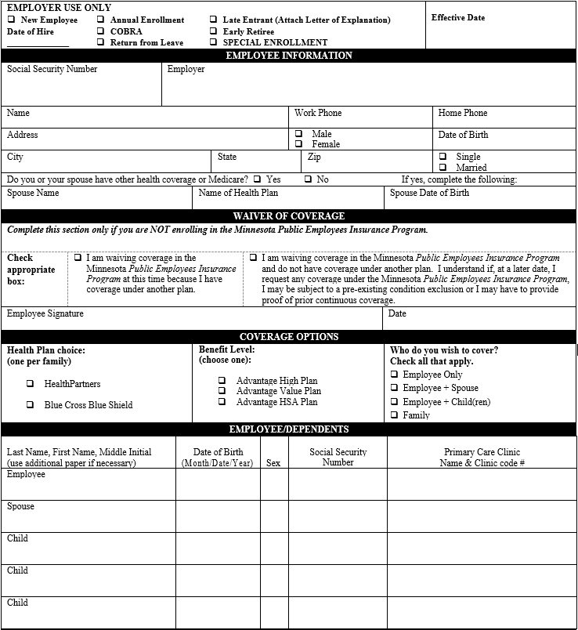
Health Enrollment Form
(if your group uses paper forms)
  Complete Employee Information Section
  Skip. Only complete ‘other health coverage’ section if you or your dependents will be double covered while on PEIP.
  Choose your health plan network (HP or BC)
  Choose your plan level (High, Value or HSA)
  Choose your coverage level.
  Complete information for all family members. Be sure to include the name and PCC # for all family members. (Match PCC # to the health plan network you choose.)
1
1
2
2
3
3
4
4

Slide 31
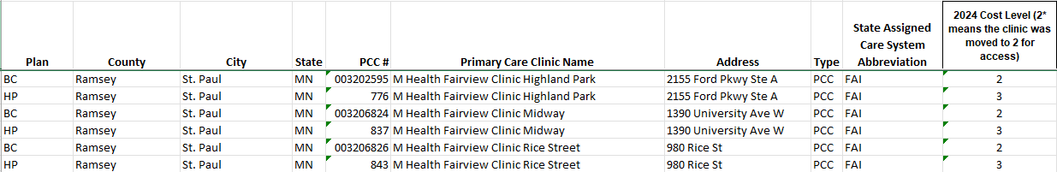
Tips
For 2025 both Blue Cross and HealthPartners are available for network selection, they are shown in the far left column as BC or HP
If you are only changing clinics make sure you call the number on your ID card to make that change.
Always check your ID card after open enrollment to make sure the information is correct.
Be sure to note the cost level and correct PCC #
that matches your
Network Carrier
(HP or BC)
when enrolling.

Slide 32
Questions
PEIP website – www.innovomn.com
For questions regarding PEIP medical coverage,
contact Innovo via phone or email.
952-746-3101 or 800-829-5601
M-F 7:30am – 4:30pm
shawn@innovomn.com
dan@innovomn.com
service@innovomn.com

